Slide 1

Is it wrong to pick up a rfid project for csc 196p
Matthew Mendoza for CSC 196P: Cloud and Mobile Pragmatics

Slide 2
EPIC Fail: Watch What Happened When I Tried Playing with RFID!
Matthew Mendoza for CSC 196P: Cloud and Mobile Pragmatics

Slide 3
I Spent 24 Hours with RFID: Here's What I Discovered!
Matthew Mendoza for CSC 196P: Cloud and Mobile Pragmatics

Slide 4


The Setup

Slide 5
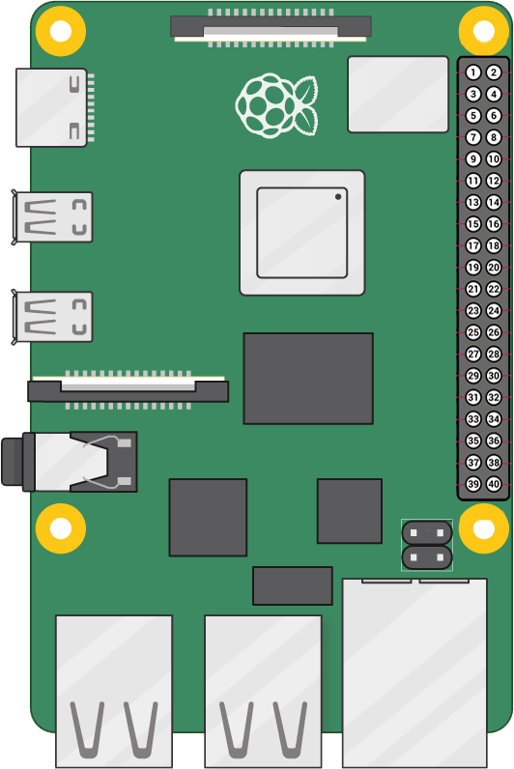
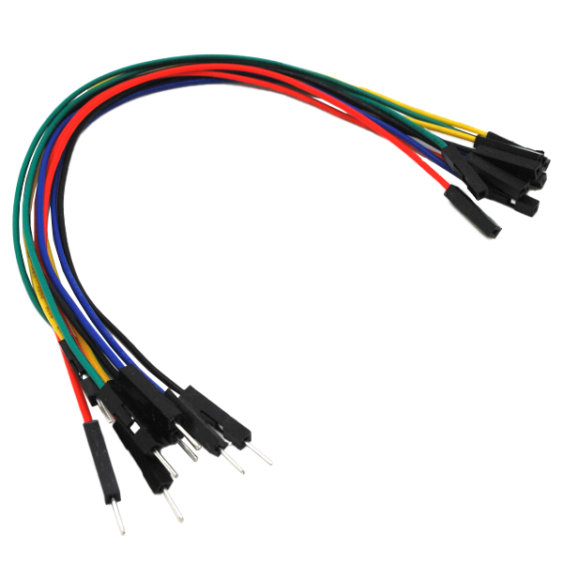
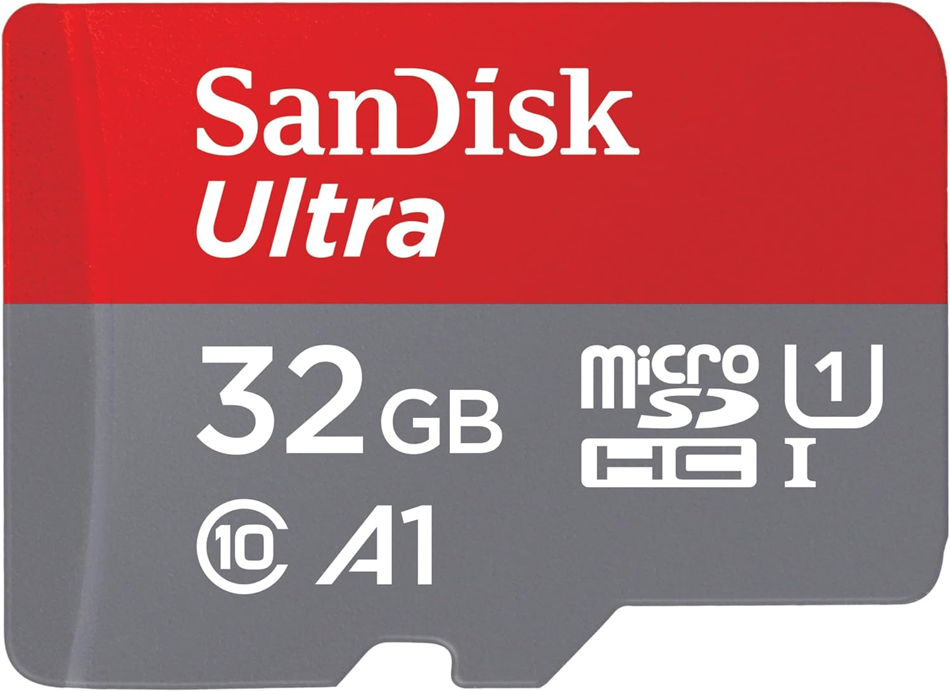
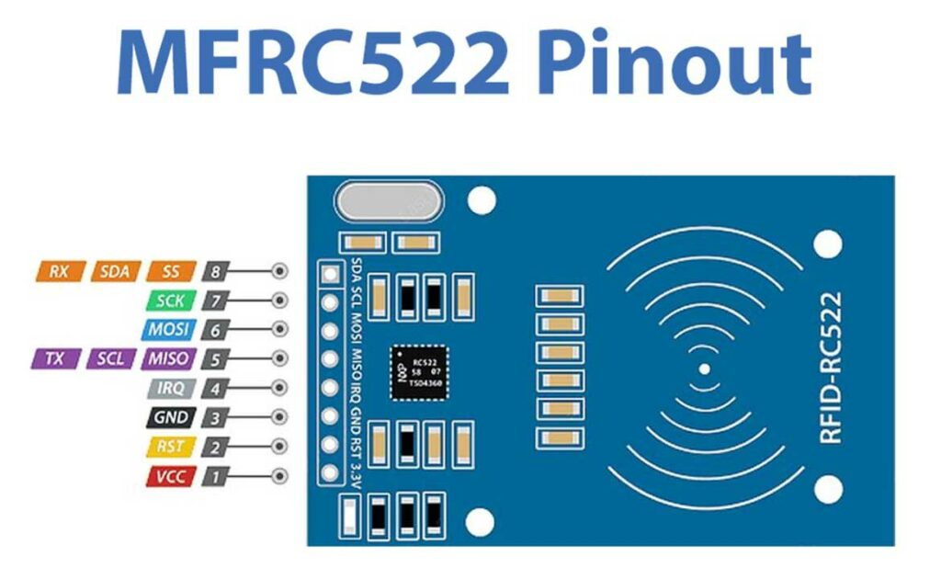
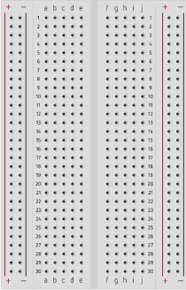


Hardware Components
Micro SD Card
Male-Female Jumper Wires
RFID Card Tag
Key Fob Tag
Mifare RC522
Module RFID Reader
Raspberry Pi 4 Model B
Breadboard

Slide 6

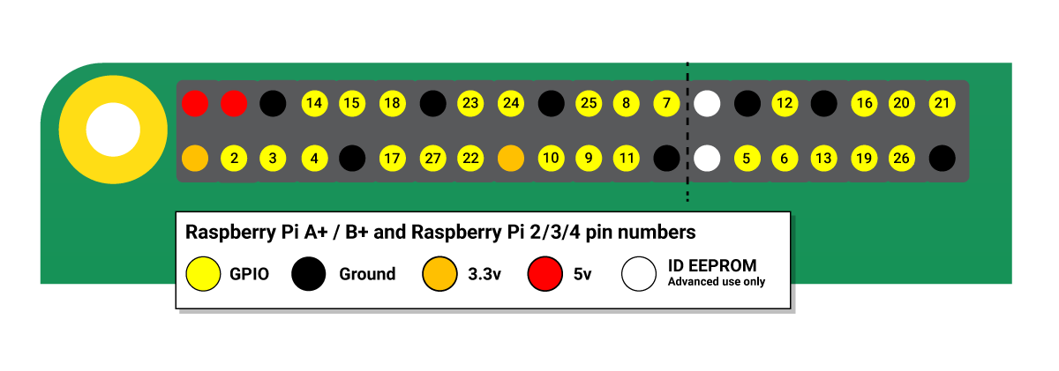
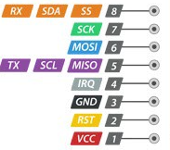
pinouts
Raspberry Pi 4 Model B
Mifare RC522Module RFID Reader
Source: Raspberry Pi GPIO and the 40-pin header, Interface RC522 RFID Module

Slide 7


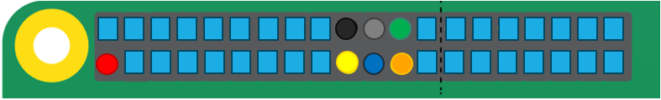
Wiring
RC522 Module (Left to Right) |  | Raspberry Pi
PIN 1: Voltage Common Collector (VCC) | Red | PIN 1: 3.3v
PIN 2: Reset (RST) | Gray | PIN 22: GPIO #25
PIN 3: Ground (GND) | Black | PIN 6: Ground (GND)
PIN 4: Interrupt Request (IRQ) |  | Not connected
PIN 5: Master In Slave Out (MISO) | Blue | PIN 21: GPIO #9 (MISO)
PIN 6: Master Out Slave In (MOSI) | GOLD | PIN 19: GPIO #10 (MOSI)
PIN 7: Serial Clock (SCK) | Orange | PIN 23: GPIO #11 (SCLK)
PIN 8: Serial Data Line (SDA) | Green | PIN 24: GPIO #8 (CE0)
Source: RC522 RFID Tag Reading with the Raspberry Pi
Notes:
RC522 Module PIN 1: Voltage at the Common Collector (VCC) - Used to Power the module, typically 3.3V is used
PIN 2: RST - Reset pin – used to reset or power down the module
PIN 3: Ground - Connected to Ground of system
PIN 5: MISO - used for SPI communication, acts as SCL for I2c and Tx for UART.
PIN 6: MOSI - Master out slave in pin for SPI communication
PIN 7: SCK - Serial Clock pin – used to provide clock source
PIN 8: SDA - Acts as Serial input (SS) for SPI communication, SDA for IIC and Rx during UART

Slide 8
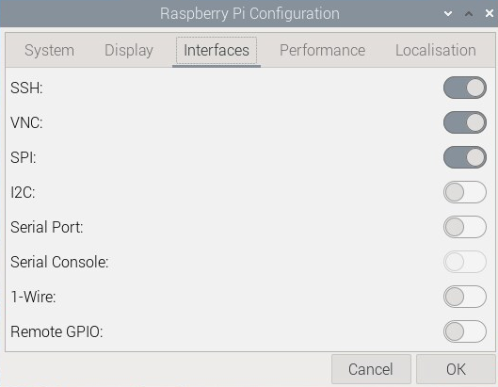
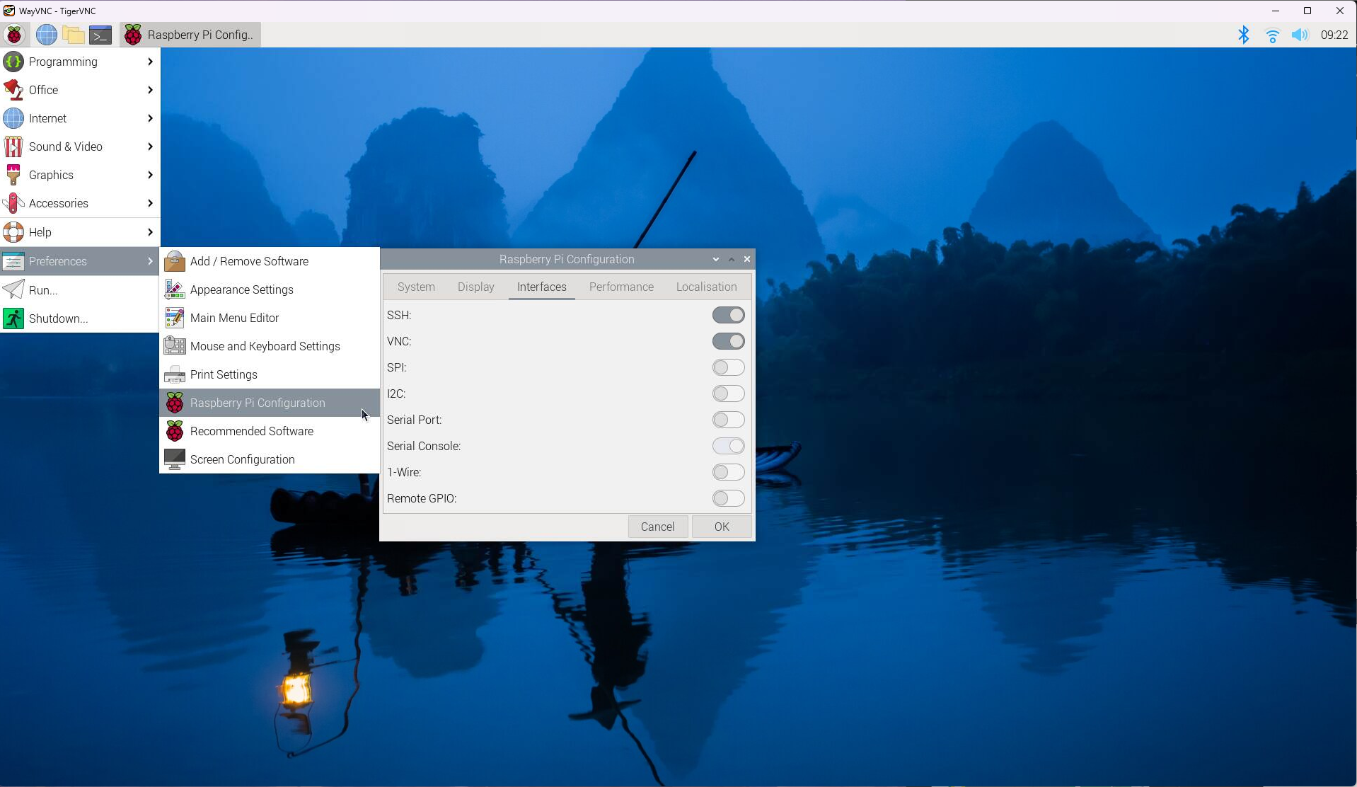
Raspberry Pi configuration
Enable Serial Peripheral Interface (SPI) connection
an interface bus commonly used to send data between microcontrollers and small peripherals such as shift registers, sensors, and SD cards. It uses separate clock and data lines, along with a select line to choose the device you wish to talk to.
1
2
3
Source: Serial Peripheral Interface (SPI)

Slide 9


Connect to the cloud via Firebase
“The cloud is just someone else's computer”

Slide 10

1) Sign-in with a google account
As of 2024/03/01

Slide 11
2) Go to console
As of 2024/03/01

Slide 12
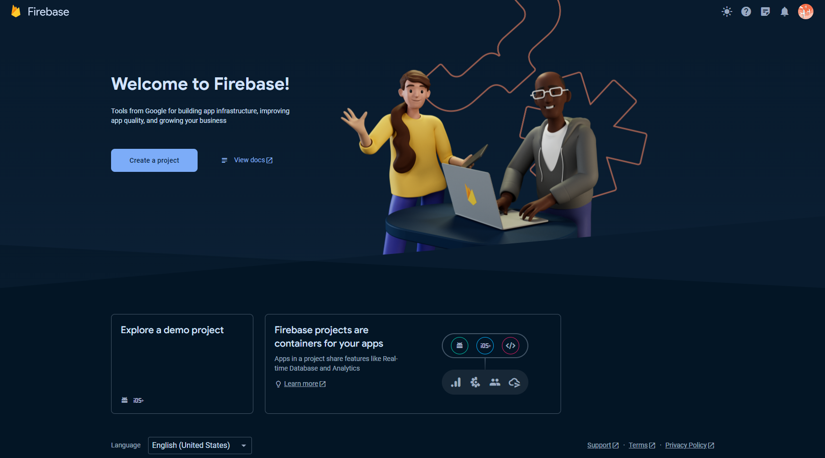
3) Create a project
As of 2024/03/01

Slide 13
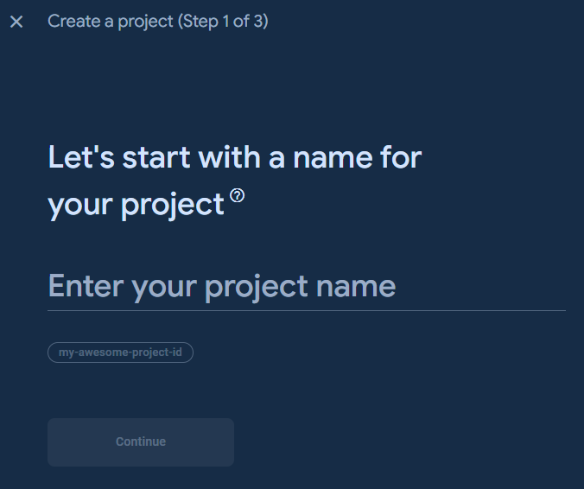

4) Give your project a name and continue
Create a project (Step 1 of 3)
As of 2024/03/01

Slide 14

5) Click Continue
Create a project (Step 2 of 3)
As of 2024/03/01

Slide 15
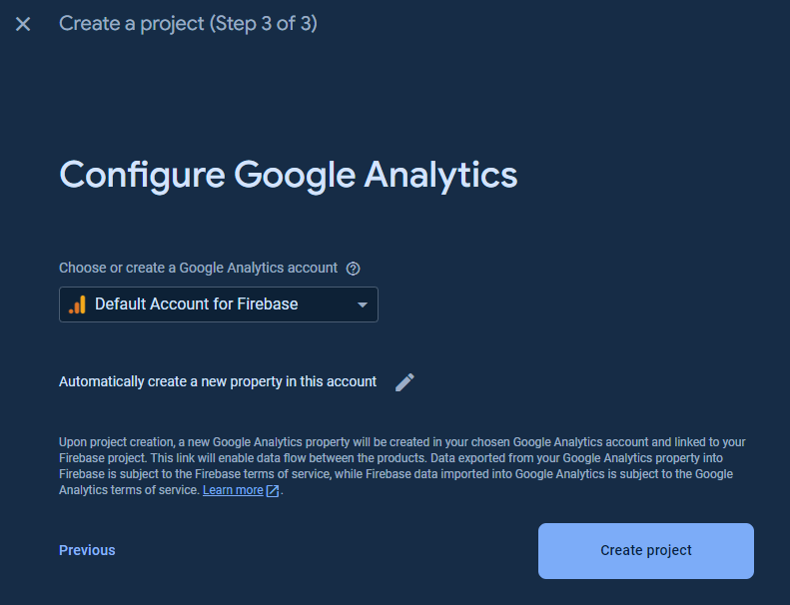
6) Configure Google Analytics
Create a project (Step 3 of 3)
As of 2024/03/01

Slide 16
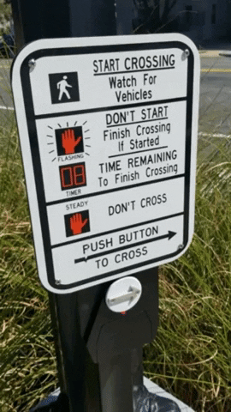
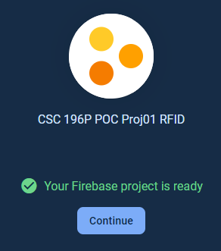
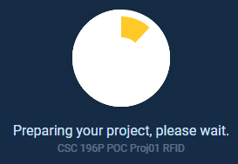
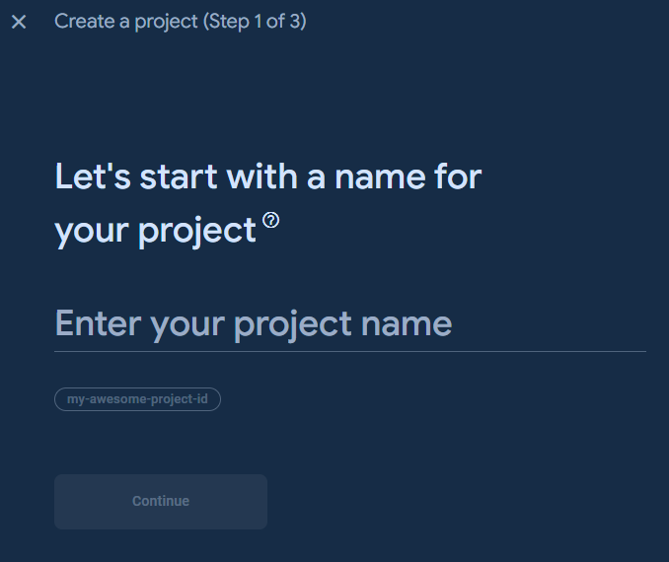
7) Wait
As of 2024/03/01

Slide 17
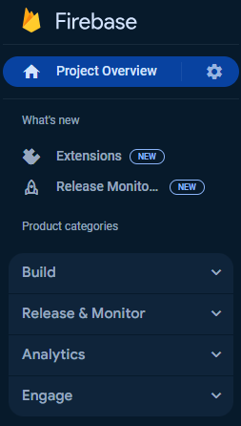
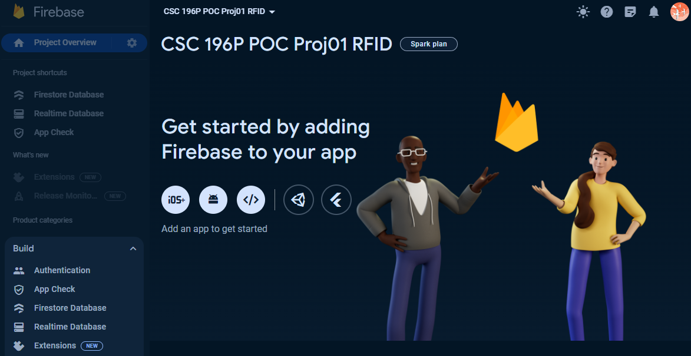
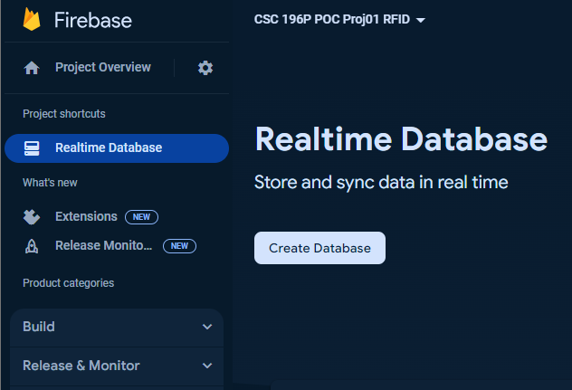
9) Create a Realtime database
From “Project categories”, under “BUILD” dropdown menu, select “Realtime Database”, Click “Create Database”
As of 2024/03/01

Slide 18
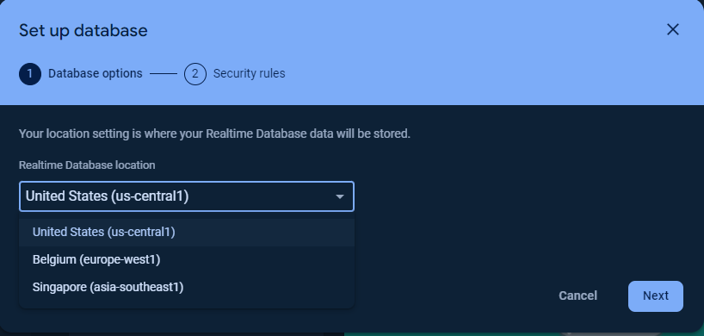
10) Set up database (part 1 of 2)
Select the region that best suits your location and click “Next”
As of 2024/03/01

Slide 19
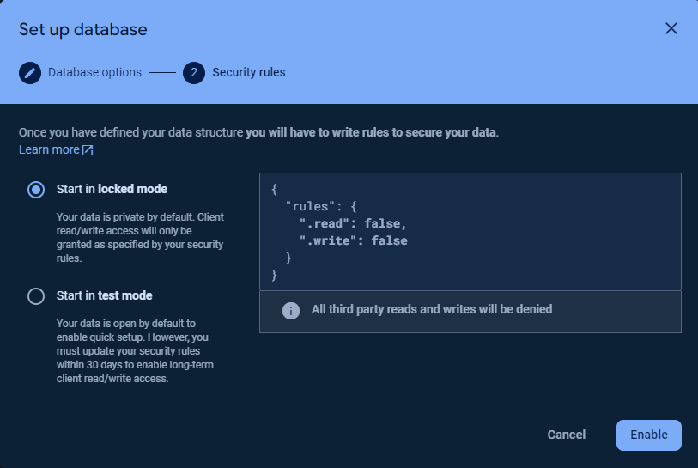
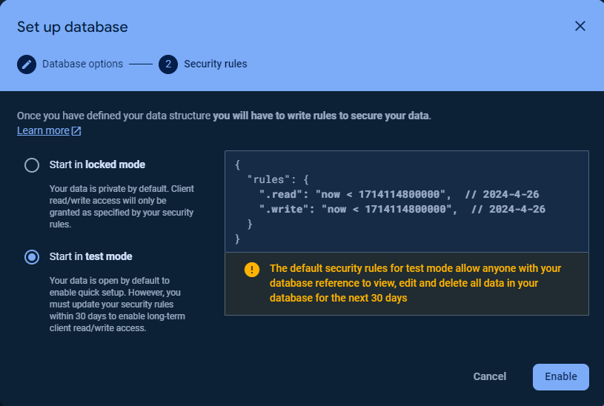
10) Set up database (part 2 of 2)
Start in locked mode
Start in test mode
As of 2024/03/01

Slide 20
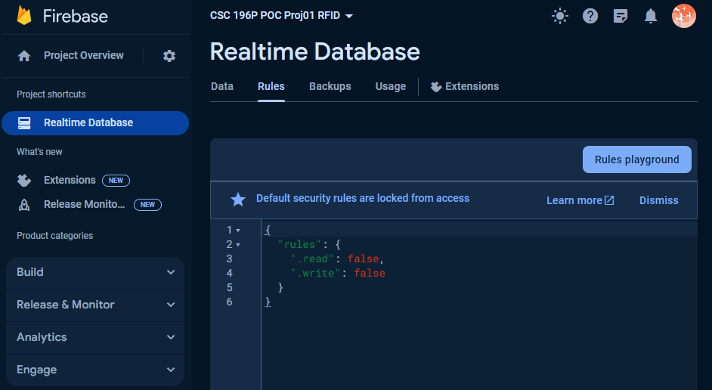
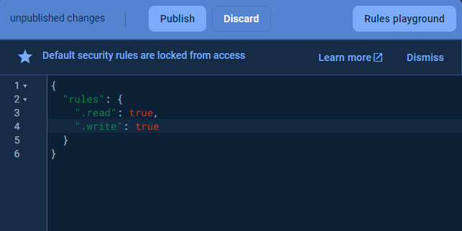
11) Edit Rules (If started in locked mode)
Go to the “Rules” tab
Change values to “true” and “Publish”
⚠️ You will get a prompt: “security rules are defined as public, so anyone can steal, modify, or delete data in your database”.
Because this is just a proof of concept this can be ignored.
As of 2024/03/01

Slide 21
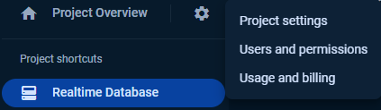
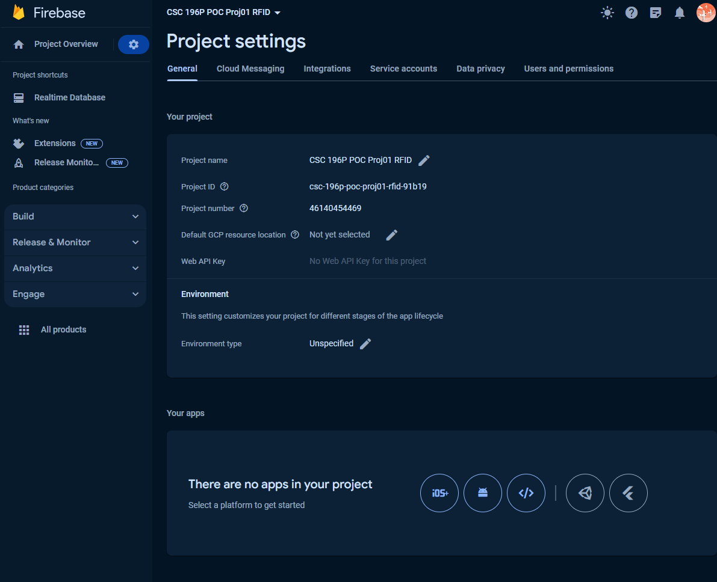
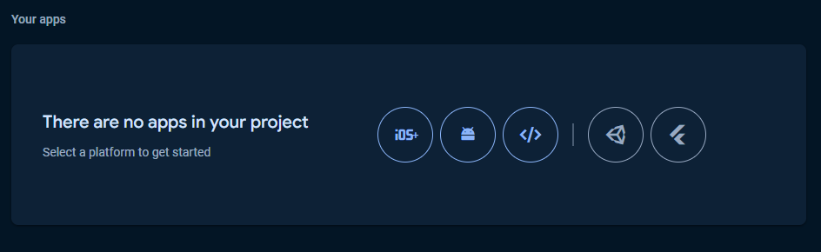
12) Project settings ➡️Add Firebase to App
Click the “gear” icon
Click “Project settings”
Scroll to the bottom of the “Project settings” page
Select the type of app you’d like to integrate with
Android
Unity (game dev)
Apple
iOS
Web
Flutter
(cross platform applications)
As of 2024/03/01

Slide 22


We are almost though

Slide 23

Implementation Web Platform via Python

Slide 24
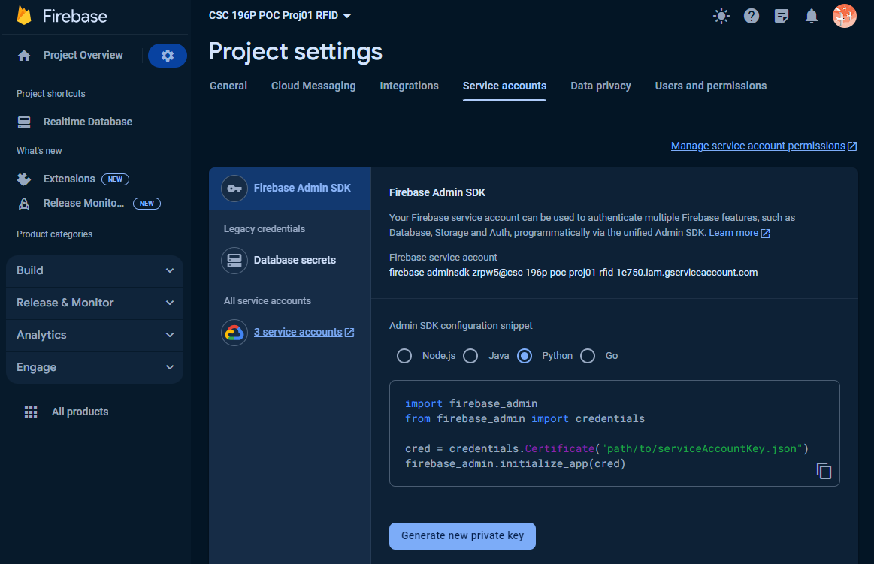
Add Firebase to your web app
To obtain the firebase_credentials.json file, you'll need to follow these steps:
Go to the Firebase Console: Visit the Firebase Console at https://console.firebase.google.com/
Select Your Project: If you already have a project, select it from the project list. If not, create a new project by clicking on the "Add project" button.
Navigate to Project Settings: Once you're in your project, click on the gear icon (settings) next to "Project Overview" in the left sidebar. Then select "Project settings".
Navigate to Service Accounts: In the project settings, select the "Service accounts" tab.
Generate New Private Key: Scroll down to the "Firebase Admin SDK" section. Under the "Firebase Admin SDK" tab, you'll see a section titled "Generate new private key". Click on the "Generate new private key" button to download the service account key file.
Save the File: Save the downloaded JSON file to a secure location on your computer. This file is your firebase_credentials.json.
Remember to keep this file secure and not share it publicly, as it contains sensitive information that grants access to your Firebase project. Once you have the firebase_credentials.json file, you can use it to initialize the Firebase Admin SDK in your Python script, as demonstrated in the previous examples.
As of 2024/03/01

Slide 25
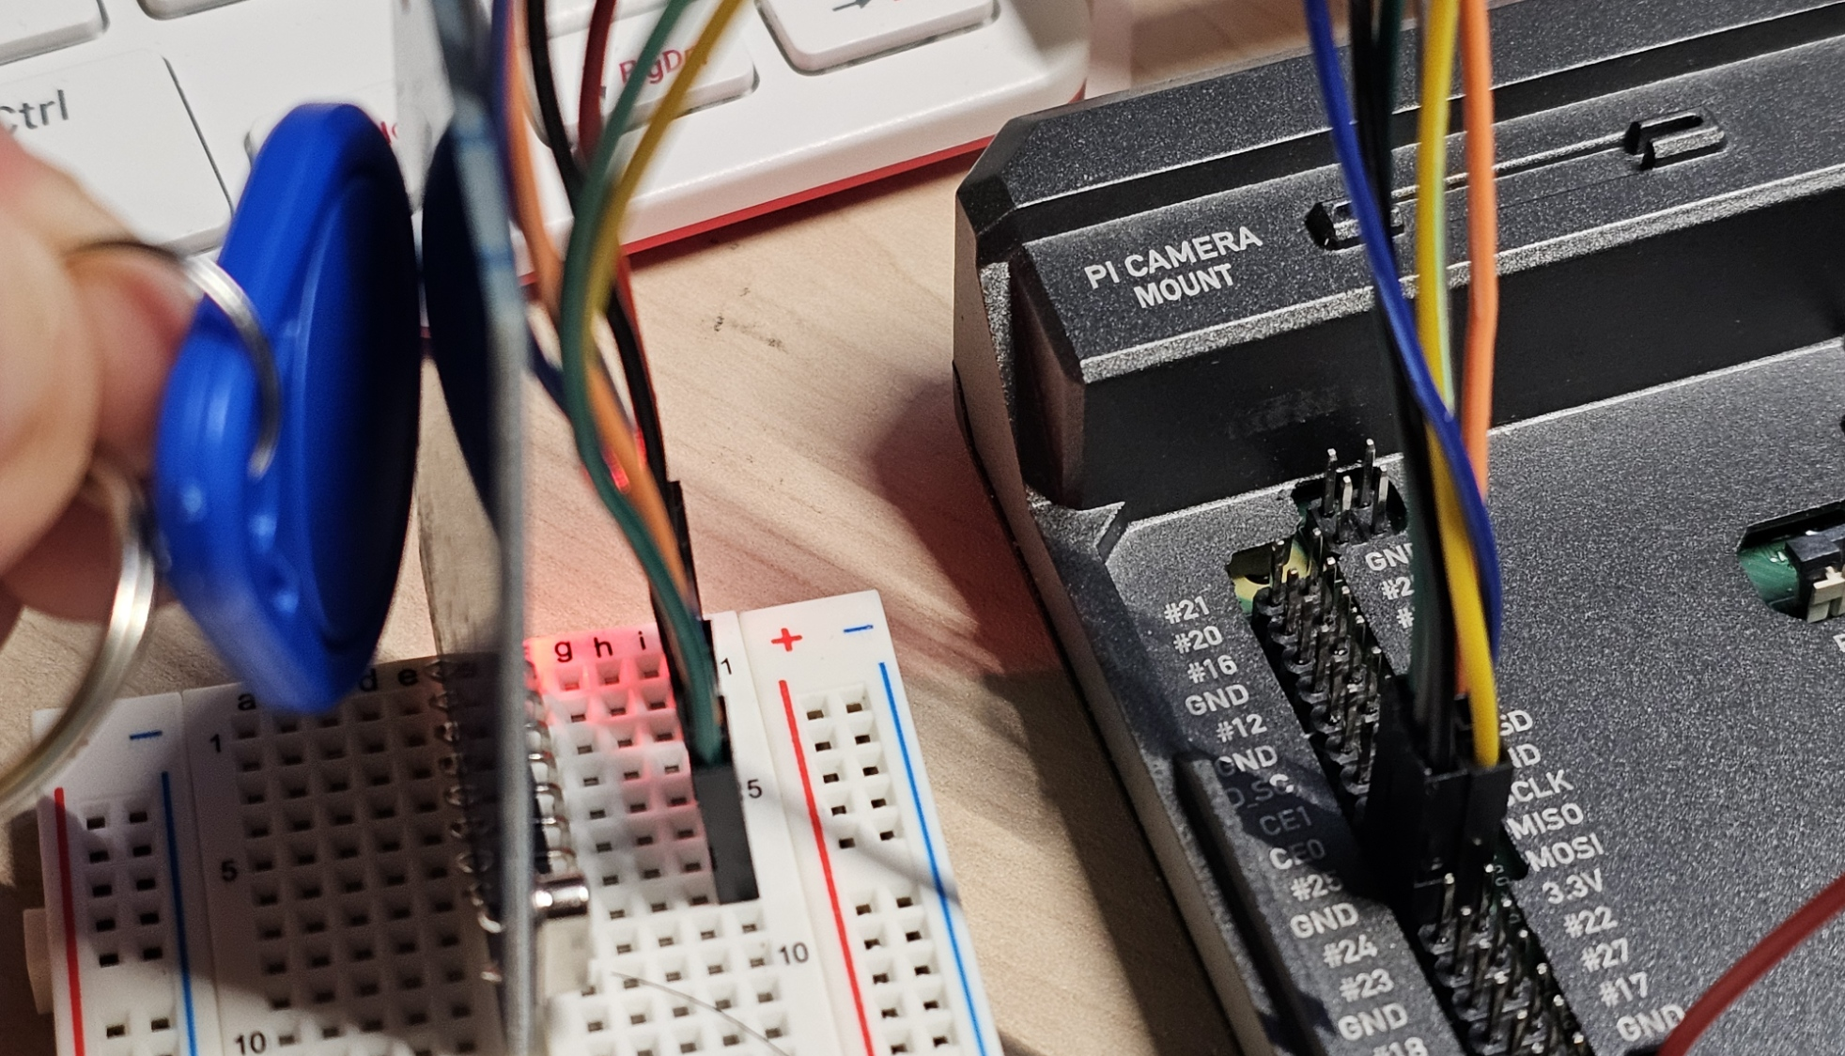
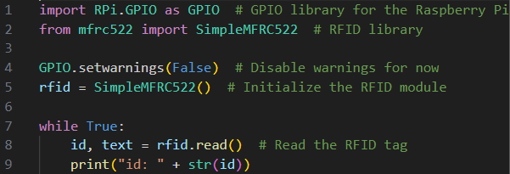
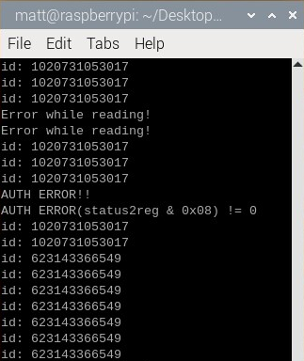
Scan for RFID Tag

Slide 26
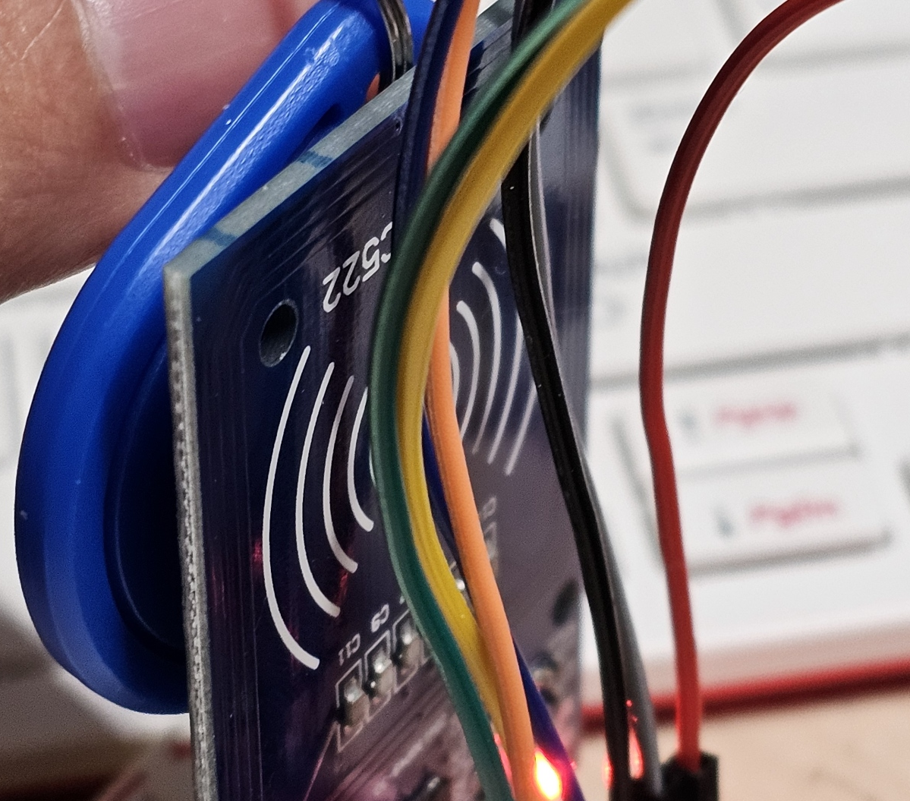
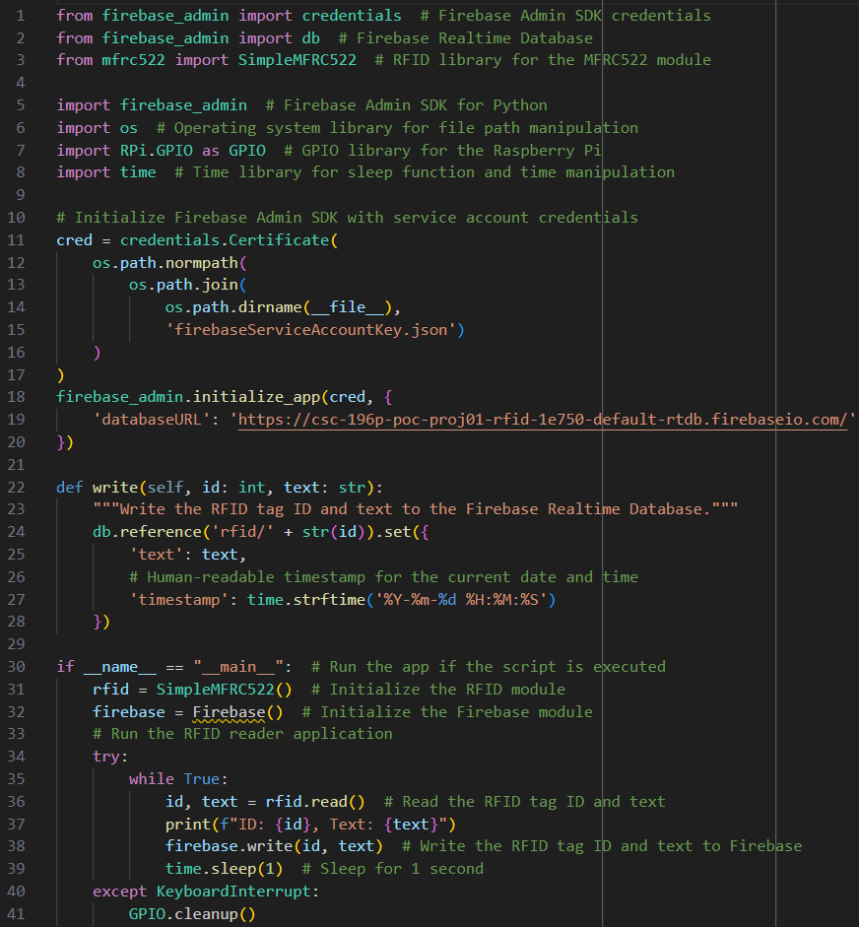
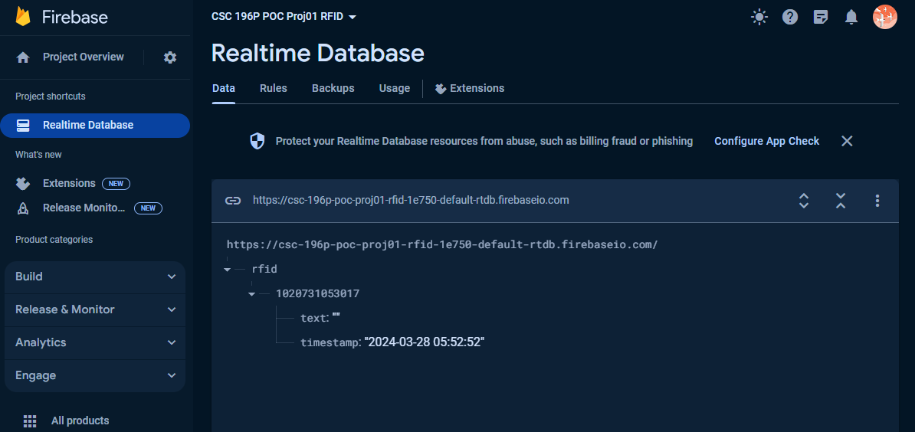
Write to Firebase Realtime Database

Slide 27


Showtime

Slide 28

The Great Swan Race!

Slide 29
Questions?

Slide 30
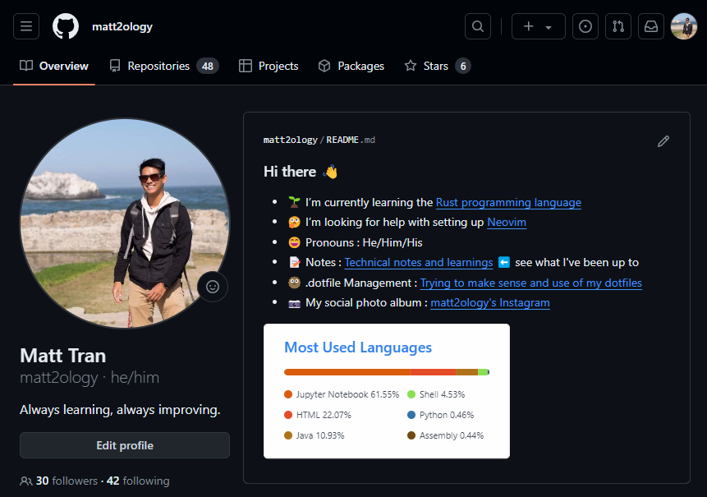
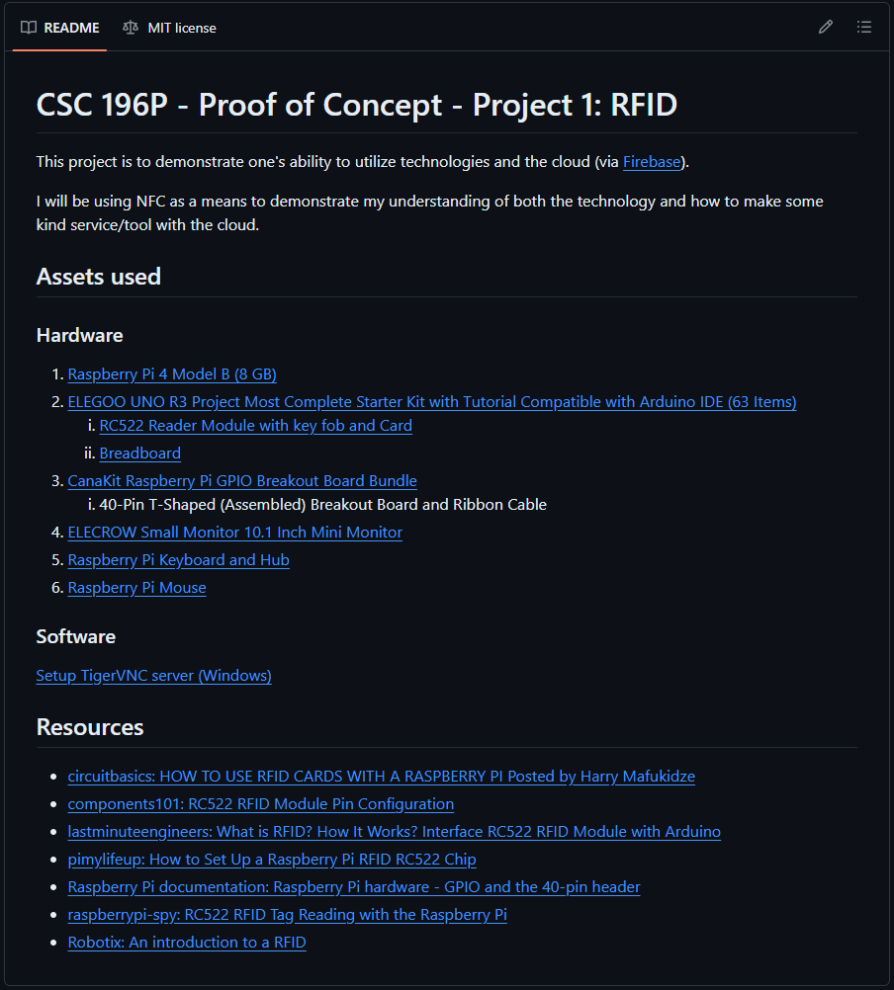
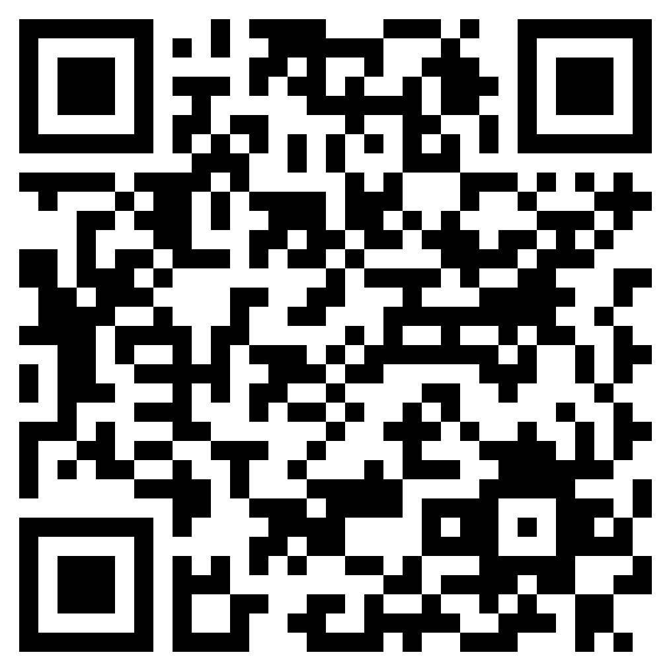
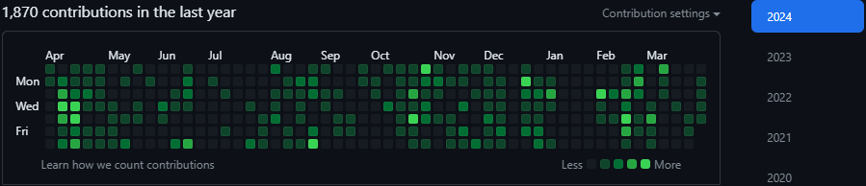
Matt2ology GitHub: POC - Project 01 - RFID

Slide 31

Thank you

Slide 32

Backup Slides

Slide 33
Wiring
RC522 Module (Left to Right) |  | Raspberry Pi
PIN 1: Voltage Common Collector (VCC) | Red | PIN 1: 3.3v
PIN 2: Reset (RST) | Gray | PIN 22: GPIO #25
PIN 3: Ground (GND) | Black | PIN 6: Ground (GND)
PIN 4: Interrupt Request (IRQ) |  | Not connected
PIN 5: Master In Slave Out (MISO) | Blue | PIN 21: GPIO #9 (MISO)
PIN 6: Master Out Slave In (MOSI) | GOLD | PIN 19: GPIO #10 (MOSI)
PIN 7: Serial Clock (SCK) | Orange | PIN 23: GPIO #11 (SCLK)
PIN 8: Serial Data Line (SDA) | Green | PIN 24: GPIO #8 (CE0)
Notes:
RC522 Module PIN 1: Voltage at the Common Collector (VCC) - Used to Power the module, typically 3.3V is used
PIN 2: RST - Reset pin – used to reset or power down the module
PIN 3: Ground - Connected to Ground of system
PIN 5: MISO - used for SPI communication, acts as SCL for I2c and Tx for UART.
PIN 6: MOSI - Master out slave in pin for SPI communication
PIN 7: SCK - Serial Clock pin – used to provide clock source
PIN 8: SDA - Acts as Serial input (SS) for SPI communication, SDA for IIC and Rx during UART

Slide 34
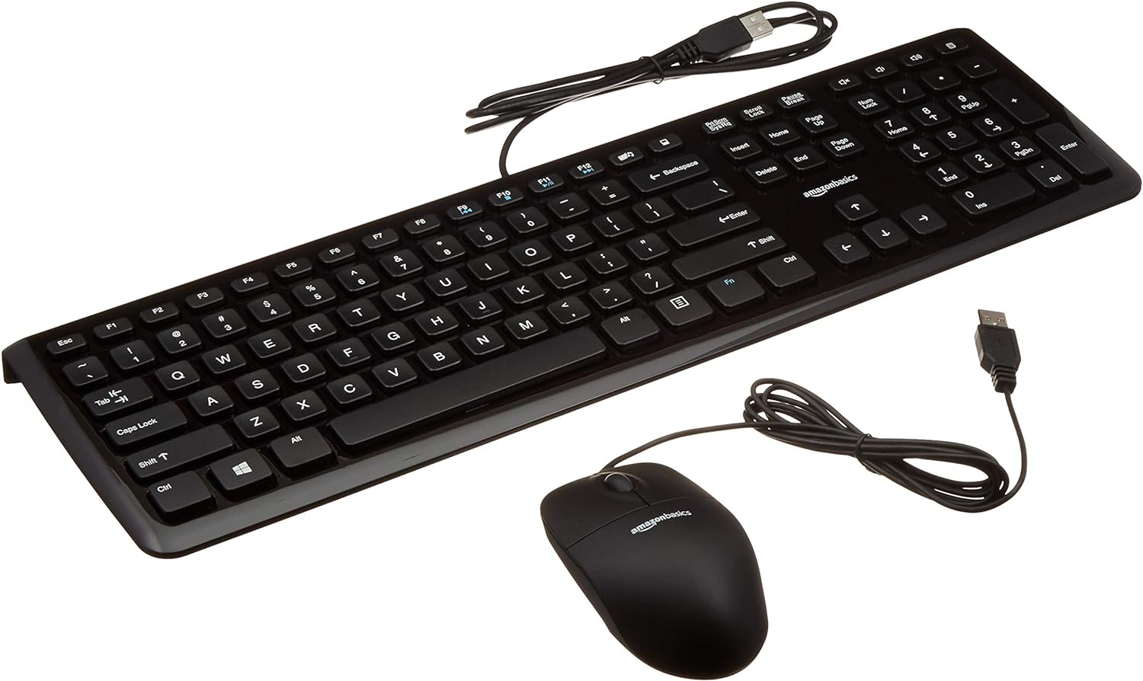

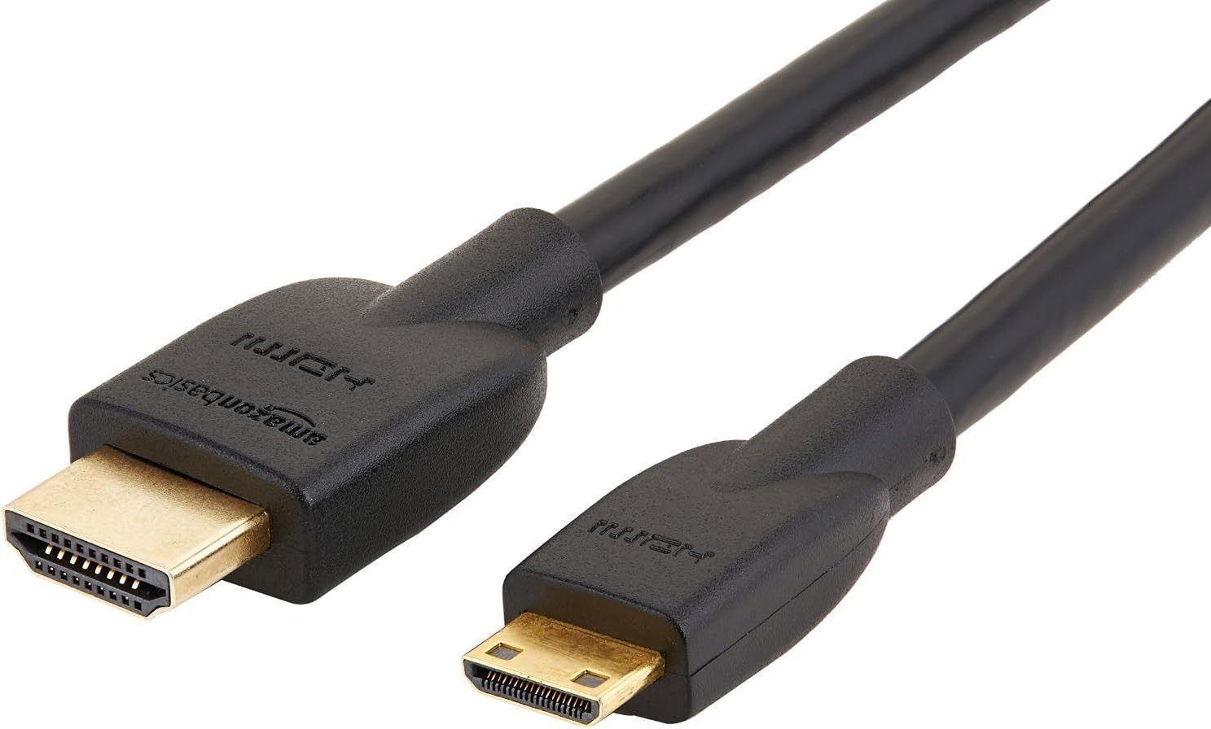
All Hardware Components
Micro SD Card
Male-Female Jumper Wires
RFID Card Tag
Key Fob Tag
Keyboard and mouse
Monitor
Mifare RC522
Module RFID Reader
Raspberry Pi 4 Model B
Breadboard
Mini HDMI to HDMI Adapter Cable

